Slide 1
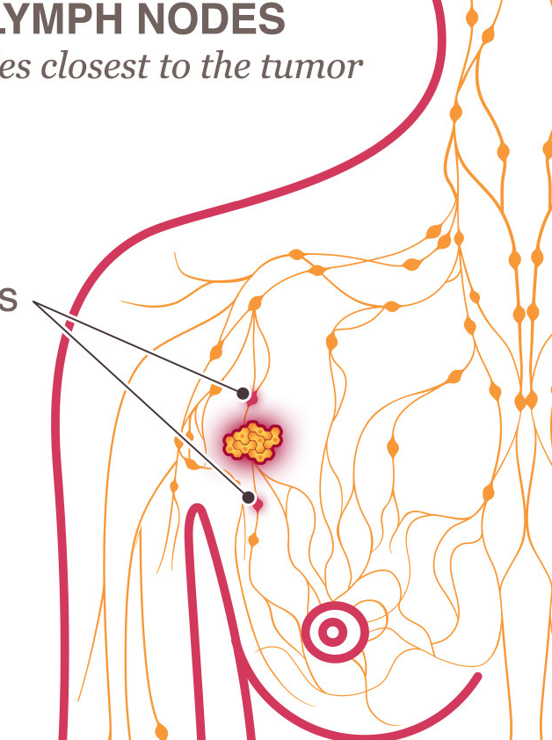
Prediction of Breast Cancer Survival
Background
2018 - > 18,000 breast cancer diagnoses / > 3,000 deaths
Early diagnosis – survival rates increase from 56% to 86%
Hypothesis –
Identification of high risk patients (poor survival) will lead to further increases in survival rates
Lymph
Nodes
Dataset
Haberman cohort
Clinical data from 306 patients (U. Chicago’s Billing Hospital)
Descriptive features (patient age, year of operation, number of positive auxiliary nodes)
Target feature (survival < 5 years and survival ± 5 years)

Slide 2
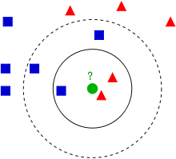
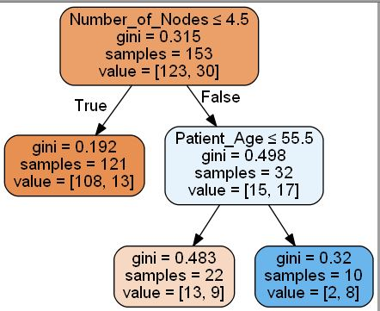
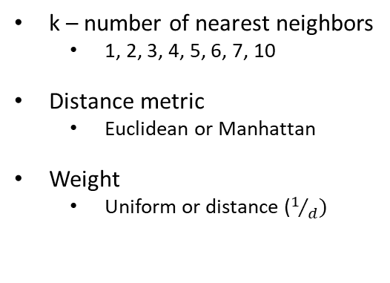
Results
Data Distribution
K Nearest Neighbors Classifier
Normalized
70
k – number of nearest neighbors
1, 2, 3, 4, 5, 6, 7, 10
Distance metric
Euclidean or Manhattan
Weight
Uniform or distance ($1/d)$
50
Number of Nodes
30
10
-10
0
20
40
60
80
Patient Age
Decision Tree Classifier
Depth
2, 4, 6, 8, 10
Min node samples needed to split
5, 10, 15, 20, 25, 30, 35
Min samples in leaf node
1, 2, 3, 4, 5, 6
Max number of leaf nodes
2, 4, 6

Slide 3
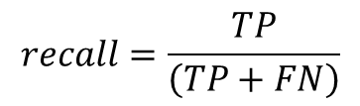
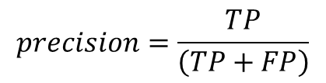
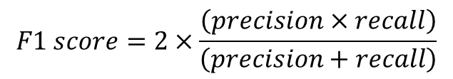
Conclusions
Both classifiers
Reasonably good at predicting based on survival status
However, poor at identifying high risk patients (survival < 5 years)
Classification Model | Survival < 5 years |  |  | Survival > 5 years
 | Precision | Recall | F1-score | Precision | Recall | F1-score | Classification error rate | Classification accuracy
kNN | 0.55 | 0.50 | 0.50 | 0.82 | 0.82 | 0.82 | 0.262 | 0.738
Decision Tree | 0.38 | 0.10 | 0.16 | 0.67 | 0.92 | 0.78 | 0.381 | 0.619
$$F1 score=2×\frac{\left(precision×recall\right)}{\left(precision+recall\right)}$$
$$precision=\frac{TP}{\left(TP+FP\right)}$$
$$recall=\frac{TP}{\left(TP+FN\right)}$$

